Slide 1
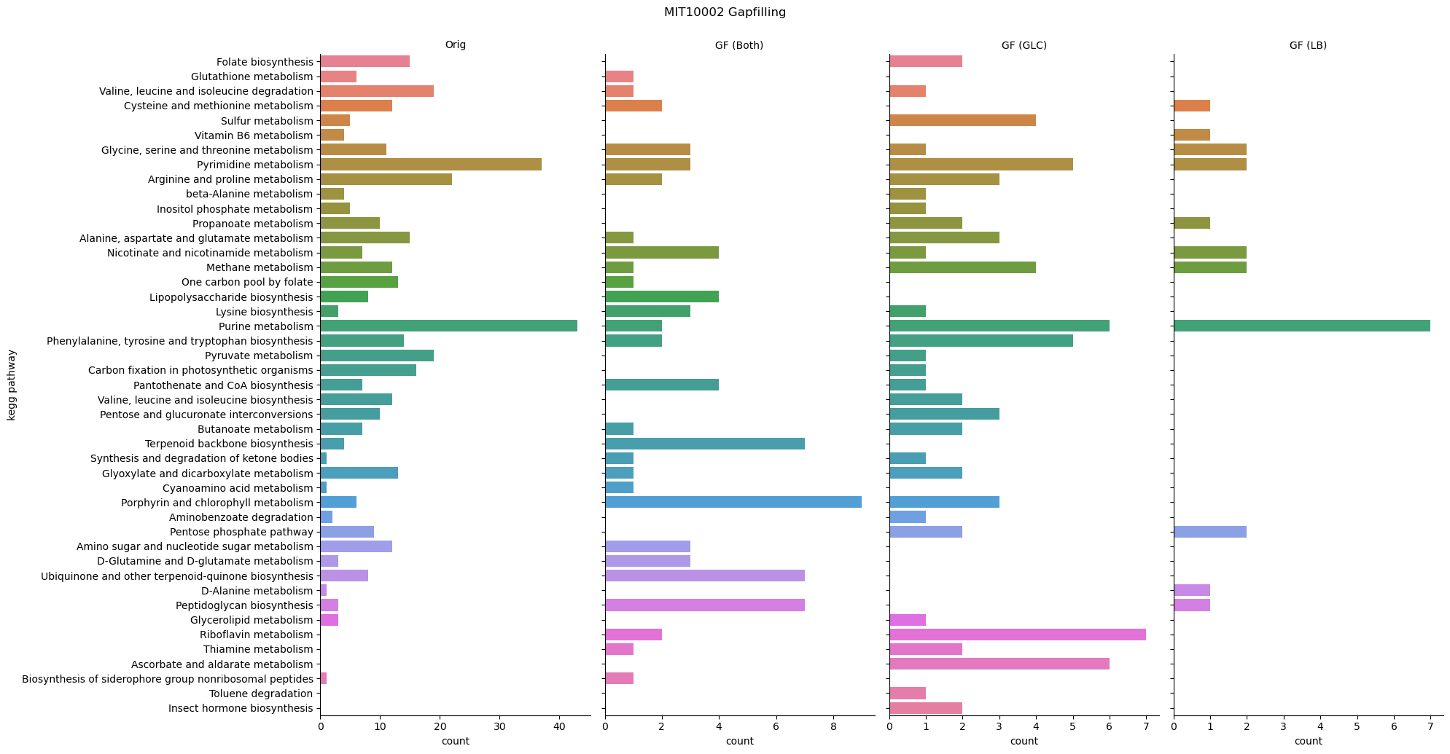
MIT1002
KEGG categories where reactions were added by gapfill
Overlap between both gapfills
Reactions unique for a specific gapfill

Slide 2
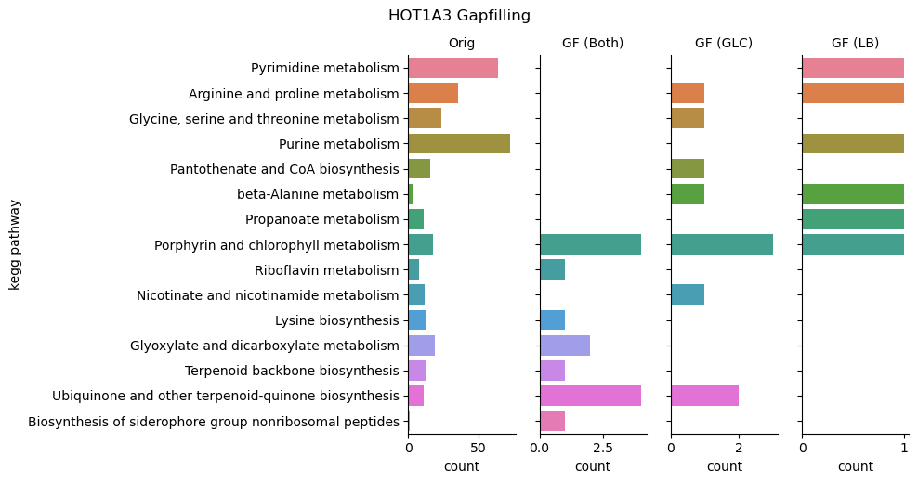
HOT1A3
KEGG categories where reactions were added by gapfill
Overlap between both gapfills
Reactions unique for a specific gapfill

Slide 3
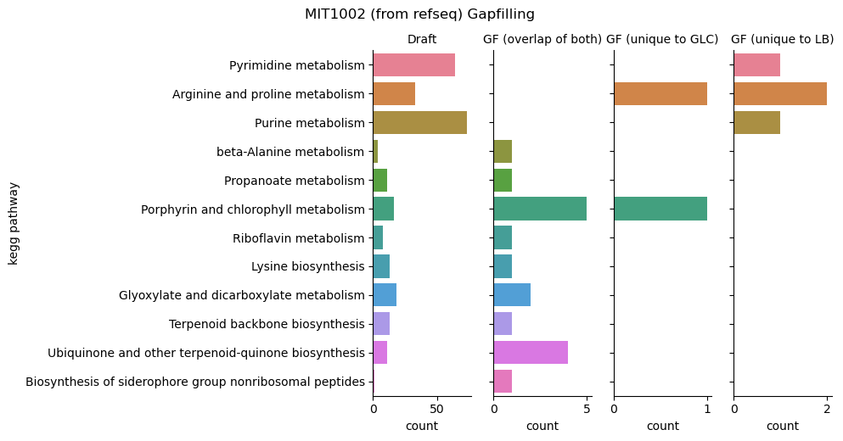
 | Draft | GF (overlap of both) | GF (unique to GLC) | GF (unique to LB)
KEGG RXN | 20 | 0 | 0 | 0
MS RXN | 987 | 5 | 0 | 1
No | 241 | 21 | 6 | 4

